Slide 1
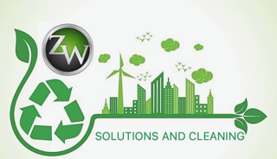
Sustainable Construction
ZERO WASTE -Stahl Project Scope
At ZERO WASTE, we are dedicated to designing protocols to support companies in achieving ZERO WASTE certification.
We carry out sustainable constructions by utilizing their waste, ensuring they are 100% eco-friendly, free of pollutants, and durable.
Our Process Includes:
We analyze each of your waste materials to ensure they are non-toxic and do not cause contamination in construction processes. If any waste does not meet the sustainability requirements for recycling in construction, ZERO WASTE will provide the best recommendation for its final disposal, ensuring minimal environmental impact.
Using sludge from your processes, along with plastic, metal waste, natural fibers such as cellulose (cardboard), and wood, we develop various construction materials, including 100% eco-friendly panels and bricks.
At ZERO WASTE, all our production and material manufacturing processes are certified by the National Standardization and Certification Body for Construction and Building (ONNCCE). They also meet the structural and fire testing requirements of the Mexican Cement and Concrete Institute (IMCYC) and hold Patent No. 220242.
All our constructions are 100% made from recycled waste, allowing for fully funded projects that include labor, permits from authorities, and, of course, all materials used.
The waste generated during the construction will have documented manifests, and, most importantly, certificates of proper disposal, providing a guarantee and certification of their destination.
We deliver monthly progress reports comparing construction progress vs. transformed waste, ensuring process sustainability.
We prepare, deliver, and submit the Environmental Operations Register reports to the relevant authorities to obtain project certification, enabling our clients to become a zero-waste company.

Slide 2
Sustainable Construction Panel
Patents and Features:
This element is used for walls and slabs. It is designed and manufactured with Mexican technology based on a three-dimensional high-strength steel structure, which houses a plastic fiber element inside, made from recycled materials. This component serves as a thermal and acoustic insulator, replacing materials derived from non-renewable resources such as petroleum (e.g., Styrofoam and Polyurethane). In this way, polluting plastics are transformed into useful construction elements.
Ready to install and finish with the coating of your choice, our panel is certified by the National Standardization and Certification Body for Construction and Building (ONNCCE) and has undergone structural and fire testing in the laboratories of the Mexican Cement and Concrete Institute (IMCYC). Patent Title No. 220242.
Insulating Coatings:
Composed of two steel sheet faces, which can have different geometries, finishes, and protective coatings. Our panel is made from treated recycled plastic fibers, which serve as thermal and acoustic insulation. Additionally, it is non-flammable and does not propagate fire, thanks to its fire-resistant additives. The panel also includes one or more hollow ducts to house installations.
Ready to assemble and fix, these panels are ideal for constructing walls and roofs, reducing construction times while enabling a clean and cost-efficient project. Patent Title No. 3539.

Slide 3
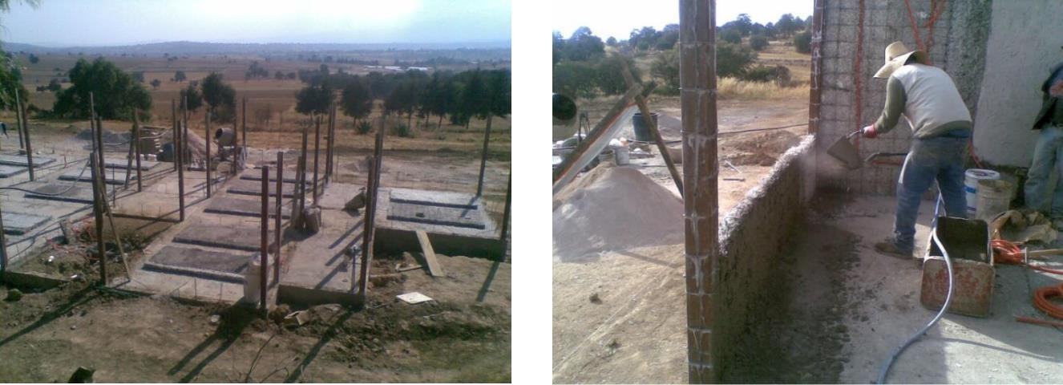
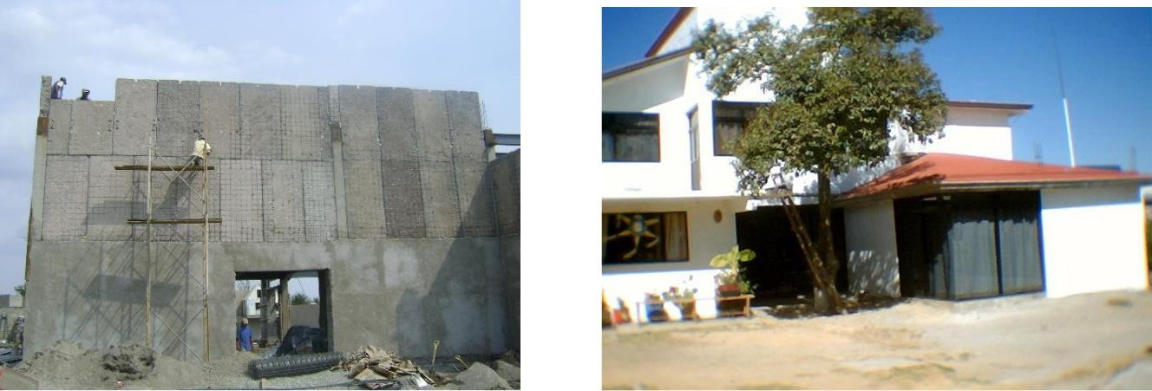
Sustainable Industrial Constructions
Obras sustentables
Sustainable Industrial Constructions
Characterized by its simple execution, it is lighter than traditional construction systems, behaves elastically in the presence of earthquakes, offers thermal and acoustic insulation, and is as strong as required by the structural design.
The purpose of this innovation is to provide society with a new construction system based on a mixed structure of permanent formwork and steel, which houses concrete and rebar according to the structural design. This system incorporates walls and slabs made of ecological panels, resulting in a unique and eco-friendly construction.
Patent Application No. MX/a/2010/010428.

